Slide 1
Smart Transport Conference: Funding requirements for a viable local transport plan
Anne Shaw
Managing Director, Transport for West Midlands
Notes:
NOTES
Good morning everyone, it’s a pleasure to be with you here today.
I have a few slides that I would like to talk to. They cover:-
Who we are - Transport for West Midlands (TfWM),
The major policy challenges we are facing and how we are responding to those.
How transport decarbonisation poses the biggest challenge – in terms of policy, future planning and funding.
How our investment programmes are responding to decarbonisation.
And finally, how we might need to think a little different about future investments to met future challenges.

Slide 2
Transport for West Midlands
TfWM invests to improve the regional transport system, working towards an integrated transport system that is safe and secure
Notes:
NOTES
One of WMCA’s key statutory functions is Local Transport Authority and through Transport for West Midlands (TfWM) it must produce a Local Transport Plan (LTP) for the area.
The LTP must set out policies to promote safe, integrated, efficient and economic transport to, from and within the area as well as plans to implement those policies.
WMCA and the seven city and metropolitan borough authorities (councils) are legally required to deliver this plan through the use of all their powers and functions.
The current LTP is “Movement for Growth” was adopted in 2016.

Slide 3

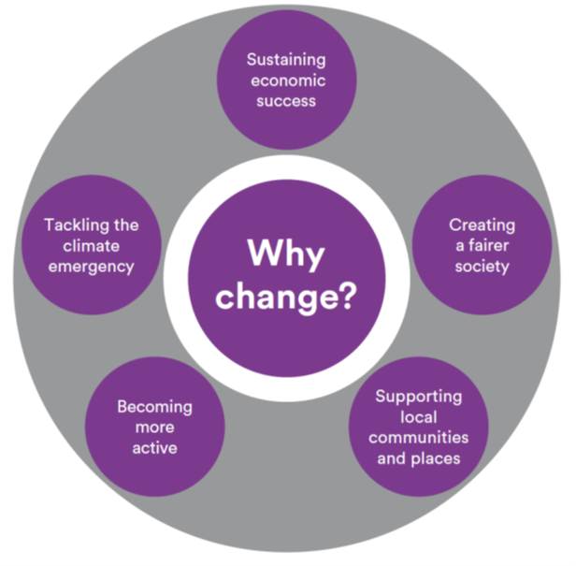
New policy agendas
Recharge the West Midlands
pandemic recovery
Inclusive
Growth Framework
sustainable and equitable advancement
WM2041
climate emergency
Local Industrial Strategy
sectoral development
Notes:
NOTES
Since last LTP was adopted there have been significant changes to policy context. This is why we are producing a new LTP.
Pandemic has had a damaging effect on our transport system - first time we have ever had to discourage public transport use.
Climate emergency
WMCA have declared a climate emergency, set a target to become carbon neutral by 2041.
Future growth
Ensure system can support every resident and visitor to get to where they need to be in the most sustainable, fair and equitable way.
Adapting to new technologies
Developing and adapting to new and future technologies and ensuring our infrastructure is ready for these changes.

Slide 4
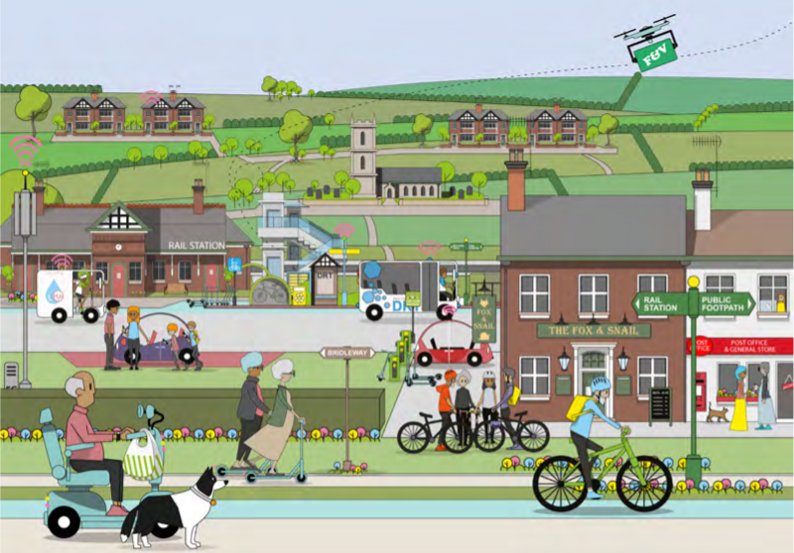
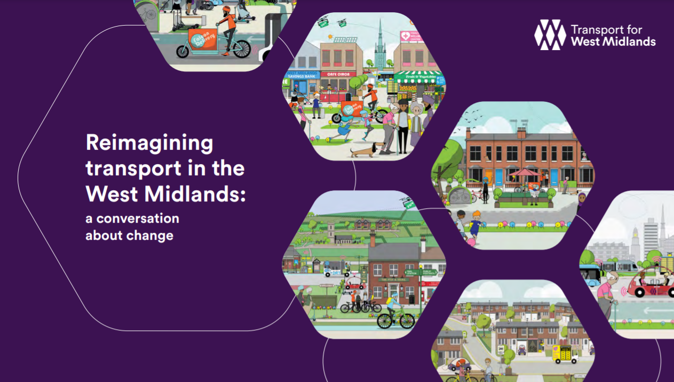
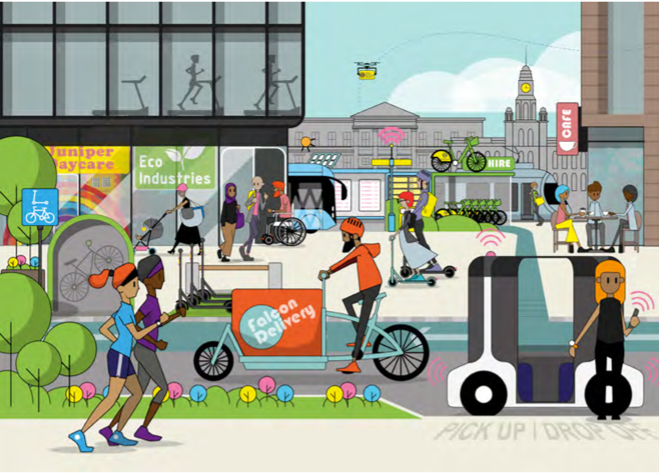
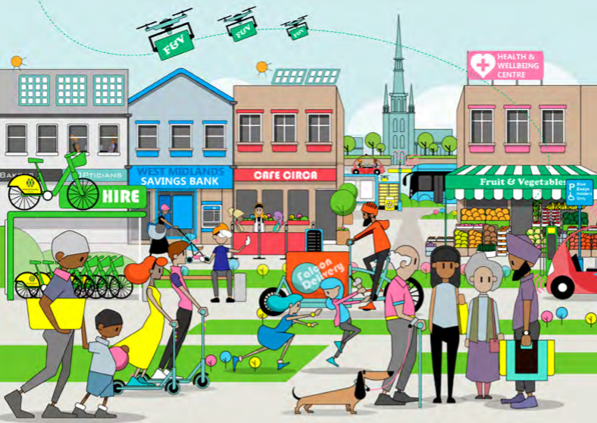
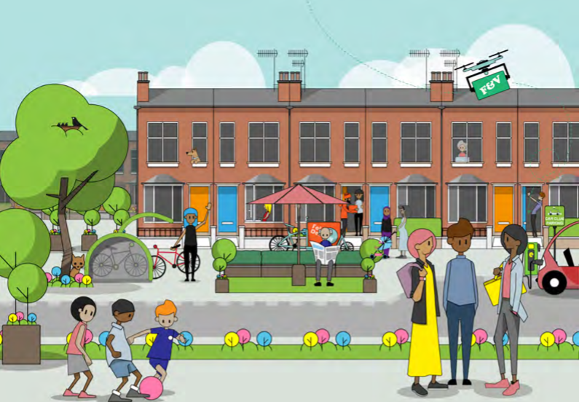
New Local Transport Plan
Alongside building a modern, resilient transport infrastructure…
…we have to consider how we can effectively change behaviour, making the most of what we already have and enhancing our liveable areas.
Notes:
NOTES
We aiming to balance the competing transport needs/opportunities with (often harmful) impacts of transport.
We have published an LTP Green Paper - setting out key challenges to resolve and explores scope of options to do this.
We are engaging across the region to understand how people and organisations want to change transport.
We have adopted 5 Motives for Change as part of the Green Paper which looks to improve the region and opportunities for all.
An underlying golden thread within this is the Climate challenge.
Means we need greater investment in PT, active travel, micro mobility alongside increasing access to digital connectivity and developing enhanced neighbourhoods.

Slide 5
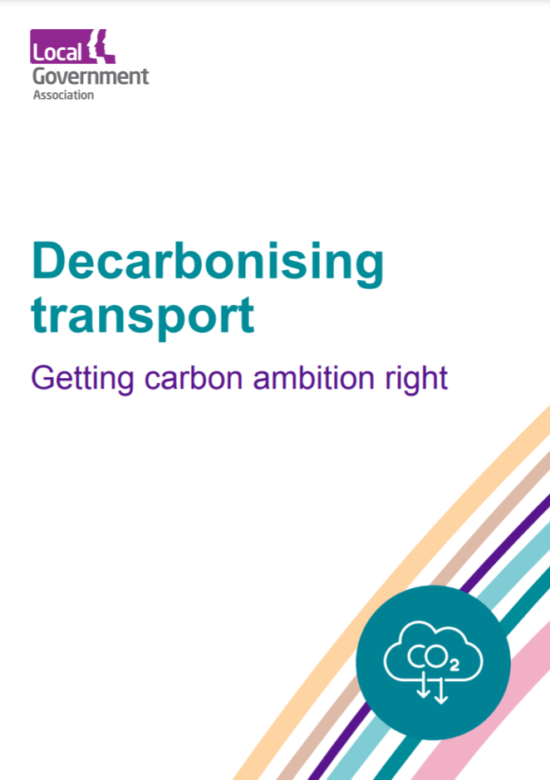
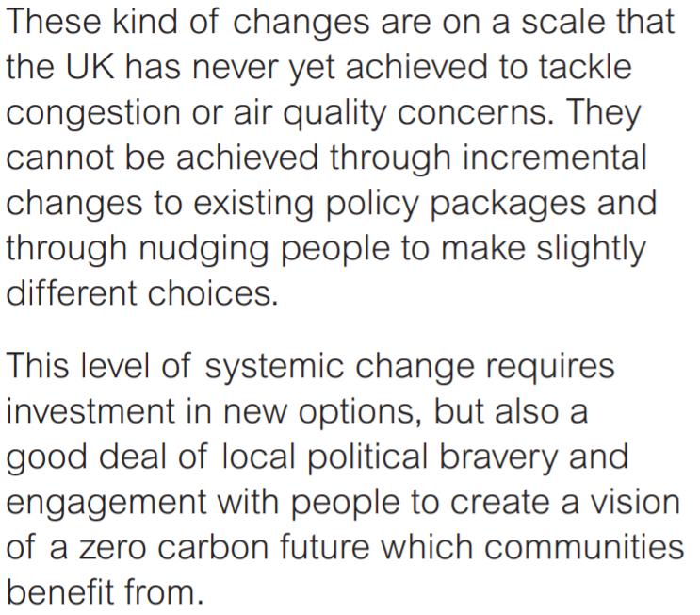
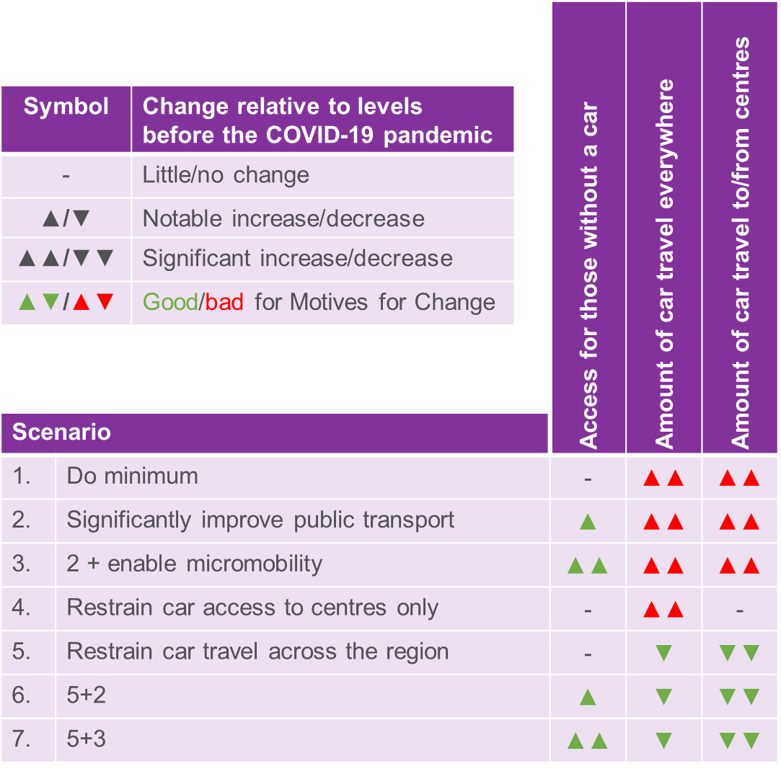
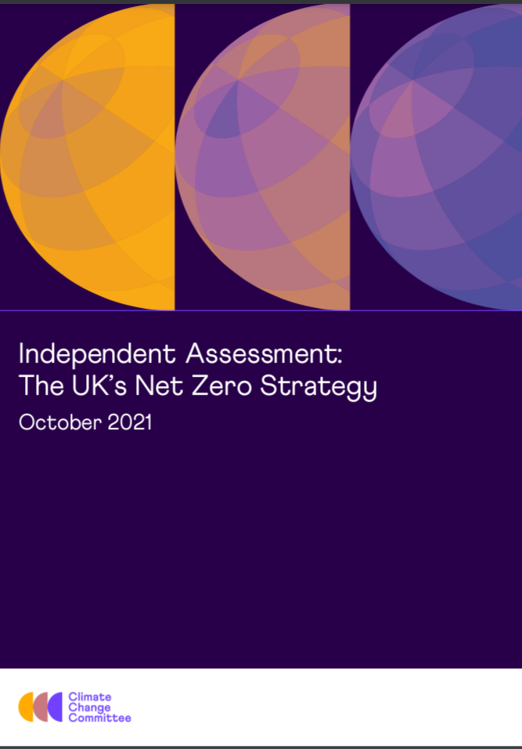
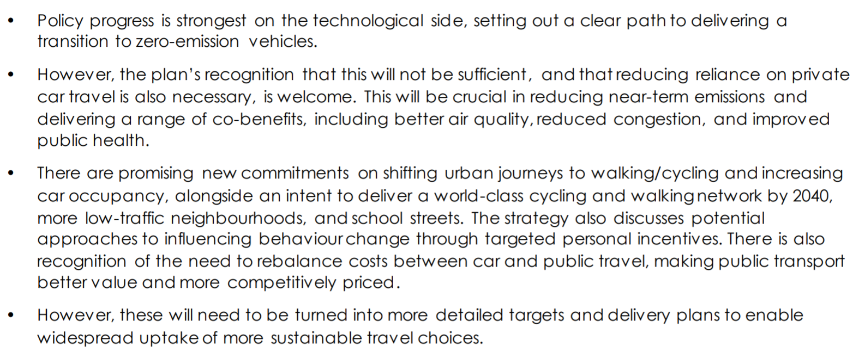
Decarbonising Transport
A shift to ULEVs is critical but insufficient. We will need to reduce the energy we use for transport through other changes to how we travel.
Notes:
NOTES
WMCA set a goal to be carbon neutral by 2041 - Transport is the biggest contributor to GHGs. HUGE challenge for TfWM.
We need change now - reductions we make over the next few years are critical.
The shift to ULEVs alone won’t be enough. Need to reduce the energy we use for transport; need to change our travel behaviours, where we travel, how frequently and using what modes.
LGA has told us that we need to go beyond incremental change and concepts such as nudge, and the Transport Decarbonisation Plan states we need to deliver significant behaviour change.
There is a gap on the detail of what is actually going to make this happen – risky measures points to local authorities to lead on this rather than commit to addressing it at the national level.
Need for clear leadership - greater consensus and sharing of political burden needed; cross party and between local and national levels.
Private sector has huge challenges to adapt i.e. access to finance, new business models, new supply chains and maintenance processes.

Slide 6
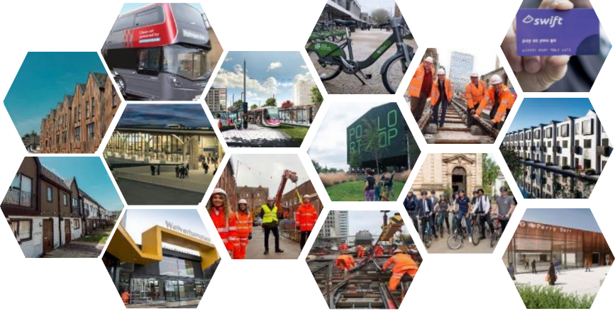
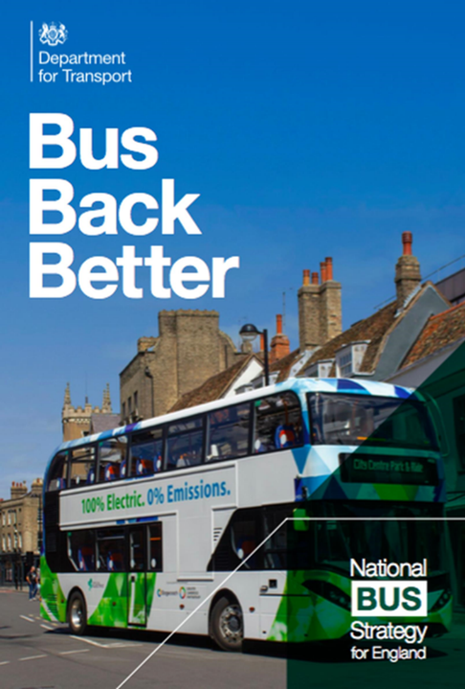

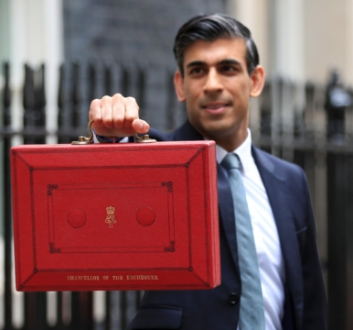
Investing in our transport system
BSIP
£1.05bn
Notes:
NOTES
Need to build on the positive impact of increased active travel uptake and encourage people back onto public transport
HS2
HS2 Growth strategy details how we are unlocking a comprehensive public transport system that encourages sustainable travel.
Building new Railway stations
Two flagship stations being rebuilt for 2022 CWG - Perry Barr and University – ready for mid-2022.
New rail stations on the Wolverhampton-Walsall & Camp Hill Line – 2023/24.
West Midlands Metro extensions
Birmingham Westside extension: Track testing and commissioning during Autumn 2021. Operational services running by December 2021.
Birmingham Eastside extension: Construction started in late spring 2021.
Wednesbury Brierley Hill extension: construction in progress, completion 2023/24.
New zero emission 3rd generation trams being delivered, to support an expanded network.
Sprint-Bus Rapid Transit: A34 and A45
Step change in mass transit network for West Midlands.
Delivering Phase 1 A45 & A34 Sprint routes for CWG 2022 and planning to start Phase 2 after CWG.
Zero emission hydrogen fleet - adding new quality and extra capacity to the network - supported by a Regional Enhanced Partnership.
BSIP & Cross City Routes
Clean Air Zone technical studies highlighted the need for new cross city routes – new through routes
Improving speed, reliability and customer experience. Schemes will benefit almost 40 million passengers per year.
National Bus Strategy offers future opportunities to improve bus services – through a Bus Service Improvement Plan – working with all bus operators to decide what is best for the WM
West Midlands Cycle Hire Scheme
Delivered 1500 bikes over the summer 2021, with 10% e-bikes and investigating further funding to expand scheme.

Slide 7
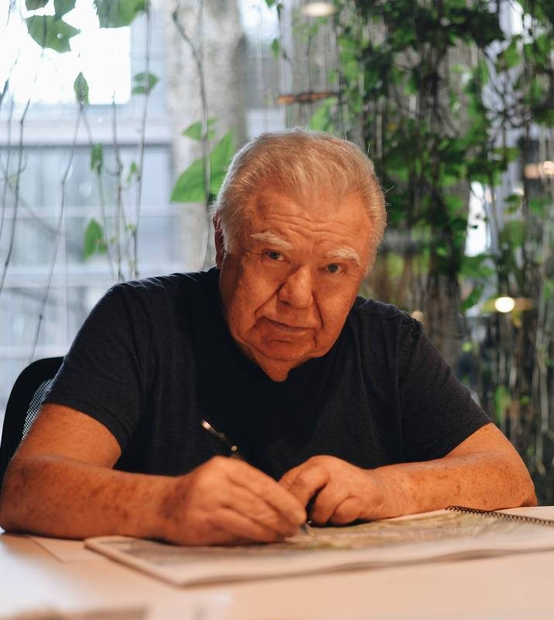
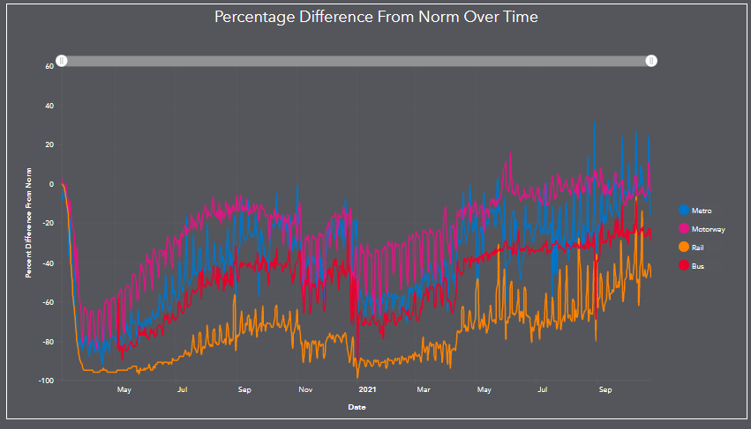
The need for future funding
“If you want creativity, take a zero off your budget. If you want sustainability, take off two zeros.”
Jaime Lerner, 3 times mayor of Curitiba and 2 times governor of Paraná
Investment based policies are not going to be sufficient to change behaviours.
…but many transport services are facing a worsening revenue challenge unless subsidy is found or fare incomes improve.
Don’t forget, consumer spending on transport is much greater than state expenditure on transport, behaviour change involves shifting that consumer spending.
Notes:
NOTES
Throwing money at the problem might not solve the decarbonisation challenge.
First time we have ever had to tell people not to travel.
The long term impact is a reduced patronage, which in turn leads to decreased revenue.
Underinvestment in our public transport system can create a vicious cycle.
We’ll need to forge new partnerships to access both public and private investment – especially to Decarbonise the transport system.
But with our significant history in transport we want to make sure we are at the forefront of any changes and gain the most for the economy and workforce.

Slide 8
Notes:
NOTES
Thank you.

Slide 9
The Department for Transport will present first (11.20am-11.35am), setting out Government policy on funding.
We would then like Anne to give a combined authority perspective (11.35am – 11.50am). Some suggested points to cover in her presentation:
• What has the requirement for local transport plans to have quantifiable carbon reduction targets to secure funding meant for TfWM and its new local transport plan?
• What are the transport funding challenges at a local level? What are the funding gaps?
• Any examples of the TfWM working with the private sector to fund transport projects.
• Future transport challenges for TfWM – I know Anne is doing a lot of work in the run up to the Commonwealth Games so would be great to touch on this if there is a funding angle .

