Slide 1

UK approach to CAVs
Head of CCAV - Isobel Pastor

Slide 2
Centre for Connected and Autonomous Vehicles
CCAV is shaping the future of transport in the UK
We lead work to mainstream the modes and business models that will meet Government objectives.
improving journeys, levelling up transport across the country
Improving safety
decarbonising journeys
growing our economy
How can these technologies have greatest impact?
How can Government support their deployment to do so?
Notes:
Benefits
Transition period

Slide 3
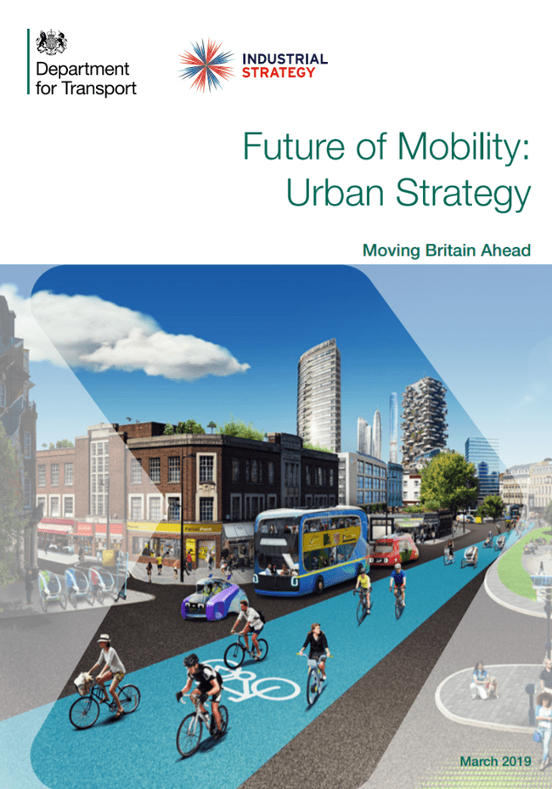
Principles for implementation
New modes of transport and new mobility services must be safe and secure by design
The benefits of innovation in mobility must be available to all parts of the UK and all segments of society​
Walking, cycling and active travel must remain the best options for short urban journeys.
Mass transit must remain fundamental to an efficient transport system
New mobility services must lead the transition to zero emissions.
Mobility innovation must help to reduce congestion through more efficient use of limited road space, for example through sharing rides, increasing occupancy or consolidating freight ​
The marketplace for mobility must be open to stimulate innovation and give the best deal for consumers.
New mobility services must be designed to operate as part of an integrated transport system combining public, private and multiple modes for transport users ​
Data from new mobility services must be shared to improve choice and the operation of the transport system
Notes:
Story so far: reg review, FTZs, strategies

Slide 4
Future Transport Zones - £92m investment
Derby & Nottingham
MaaS platform, data sharing, e-transport hubs
Solent
MaaS platform, mobility credits, demand responsive transport, e-bikes, car and lift sharing, urban logistics, transport hubs.
West of England
Data hub, MaaS platform, dynamic demand responsive transport, transport hubs
West Midlands
Building data capability, expansion of modes, mobility credits, MaaS platform

Slide 5
Unlocking Widespread Rollout
Supply
Demand
Regulation
Notes:
Supply - CAVs
Demand – Government as a customer, support rollout consistent with principles – what else is needed?
Regulation – Reg review, LC, CoP

Slide 6




Thank you
Isobel.Pastor@ccav.gov.uk
gov.uk/ccav
@ccavgovuk
Search: Centre for Connected and Autonomous Vehicles

