Slide 1
Travel planning for changing commuting, business and leisure habits
Paul Tuohy
Chief Executive
Campaign for Better Transport
Smart Transport Conference
30 November 2021

Slide 2
The pandemic affected different modes differently
Source: DfT (2021), Use of transport modes: Great Britain, since 1 March 2020
Notes:
Bus and train down: buses (green lines) currently at 80% of pre-pandemic levels, trains (orange lines) at about 70%
Active travel up: cycling (not on chart) almost tripled during the pandemic but has now settled at around pre-pandemic levels
Cars up: car use (black) is around pre-pandemic levels while vans and lorries are consistently at 110%
We face a danger of a car-led recovery

Slide 3
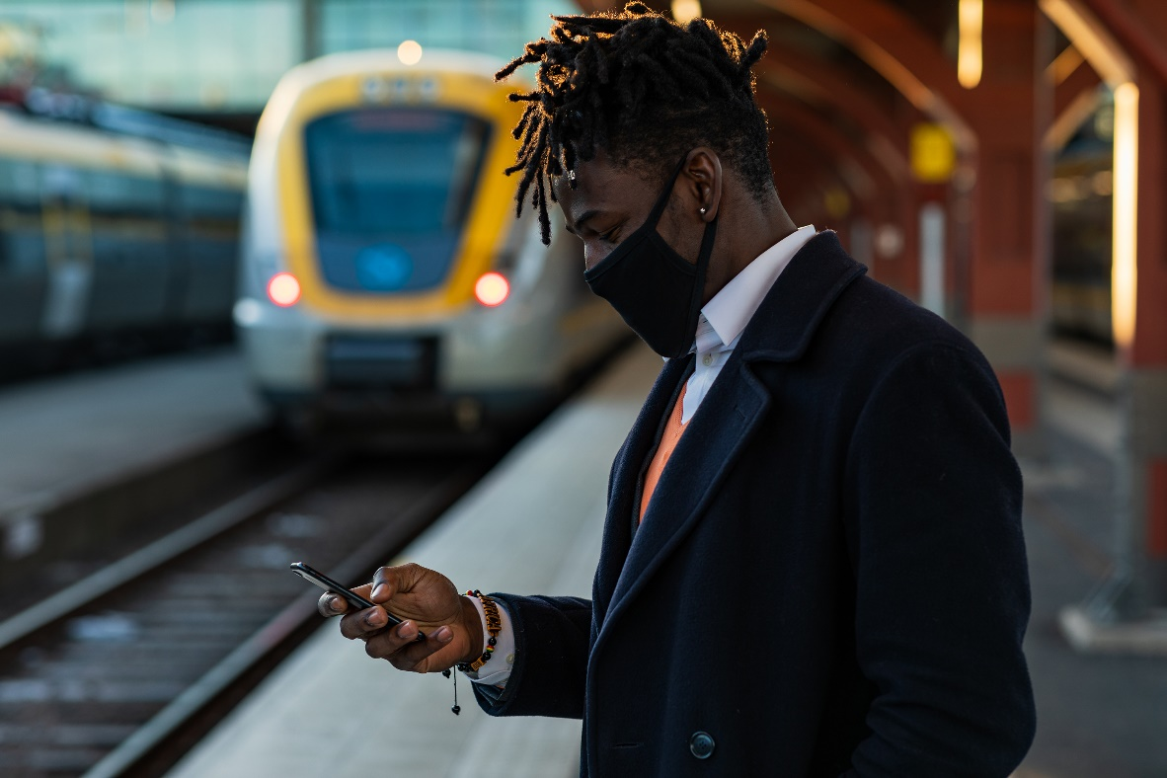
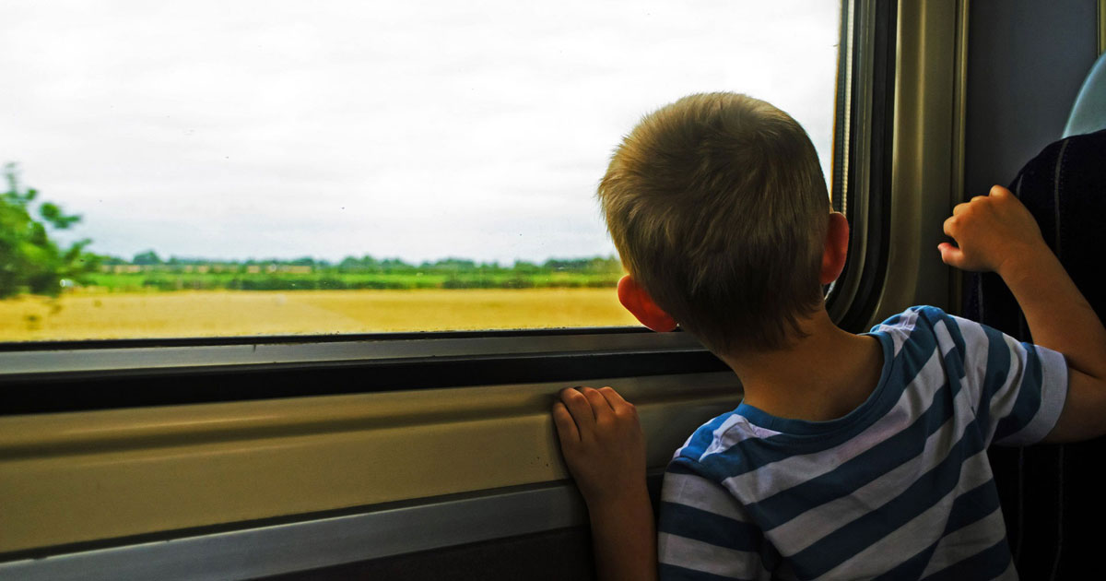
Commuting and leisure are now both discretionary journeys
Commuting
45% of pre-pandemic levels
Leisure
90% of pre-pandemic levels
55% of all rail journeys (33% in 2019)
Source: RDG ( October 2021)
Notes:
WFH has stuck and people adopting a hybrid approach to work, commuting is now a discretionary travel activity
Similar for business travel – online meetings improve productivity, although face to face meetings still needed for creative collaboration
As a result weekday travel is still subdued but leisure travel has recovered strongly so weekend trips are up

Slide 4







Sustainable transport modes should be a priority
Avoid the need to travel: reduced emissions from commuting and business travel but what is the net impact on emissions and town centre economies of working from home?
Shift to greener modes: Much more needs to be done to encourage people to return to public transport
Improve the vehicles used: main government focus on electric vehicles but they should only be at the bottom of the pyramid
Avoid
Shift
Improve
Notes:
Avoid the need to travel: less commuting and business travel contributing to reduced emissions from transport (although not if private cars continue to be the main choice). But we need to look at the net impact on emissions (heating and electricity for homes less efficient on old boilers than large offices). Also net economic impact on town centres
Shift to greener modes: much more needs to be done to encourage people to return to public transport
Improve the vehicles used: government large focus on EVs but they should be the bottom of the pyramid for those journeys that can’t be made by greener modes

Slide 5
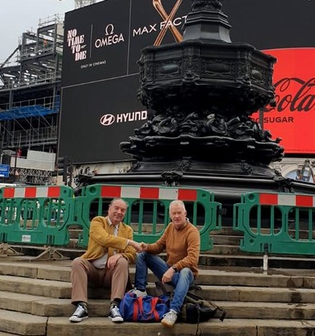
Employers can support greener journeys
Active travel
    Cycle parking and showers
    Bike purchase loans
    Cycle friendly employer scheme
Public transport
    Travel planning
    No domestic flights policy
Shared mobility
    Reduced parking
    Car clubs
    Liftshare apps and schemes
Notes:
WFH: who needs to be in when and how often
Active travel: cycle friendly policies and culture
Public transport: travel planning services by local authorities, #trainNOTplane
Shared mobility: less parking, car clubs, rideshare apps (such as Liftshare)

Slide 6
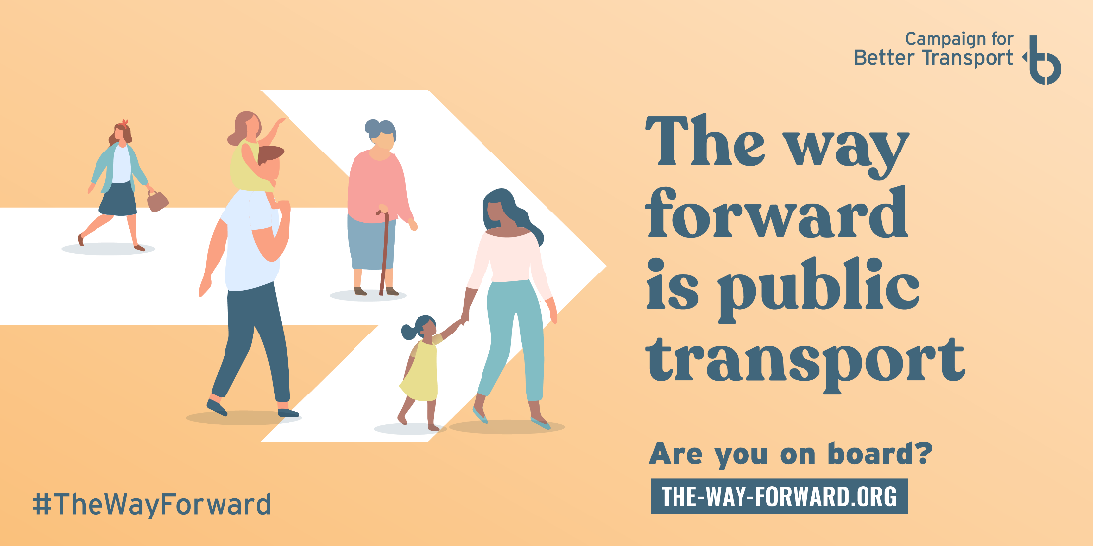
The government needs to above all promote public transport
Inequality in transport
Notes:
In terms of what government needs to do, above all, it’s a public awareness campaign to promote public transport and restore confidence in its safety post-pandemic

Slide 7
Government and local authorities must work together
Fares reform
    Root and branch reform of rail fares
    Fares freeze
    Improved flexible season tickets
    Scrap peak times
    Capping across bus operators
Requirements to improve bus services and install safe walking and cycling infrastructure in Local Transport Plans
Reduce cars’ attractiveness
    Workplace parking levies
    Charging Clean Air Zones
    Congestion charging
Modal shift
Bus services
Rail fares
Cycling infra
Workplace Parking Levies
Local Transport Plans
Pavements & crossings
Charging CAZs
Notes:
We need govt to work with LAs:
Fares reform: mention asks (we want to even out demand throughout the day but also even out pricing between operators, so why does it cost me 80% more to travel at peak times from Tunbridge Wells to London whereas my colleague pays just 8% more to travel at peak times between Southend and London?)
Local Transport Plans – requirements for local authorities to improve public transport and invest in active travel infrastructure or not get central government funding
Local authority measures to make cars less attractive: workplace parking levies, paid CAZs, congestion charging, etc.

Slide 8
Thank you for listening!
Paul Tuohy
Chief Executive, Campaign for Better Transport ceo@bettertransport.org.uk

