Slide 1
County Hall, London 30.11.2021 SMART TRANSPORT
The Cost of Achieving Net Zero
Phil Goodwin
Emeritus Professor of Transport Policy, UCL and UWE
Senior Fellow, Foundation for Integrated Transport

Slide 2
Agenda
Total cost
Fiscal cost transport
Cost of global heating
Effects on Value for Money
Base-Line?
Timing
Road Pricing
Behaviour change
Road programme , carbon costs
Two futures

Slide 3
1. How much will it cost the UK to reach net zero?
FT summary, 3.11.2021, from Office for Budget Responsibility OBR, from Committee on Climate Change CCC.
£1.4tn 2020-2050 ‘green investment’
(£50bn per year, 2% of GDP, but this brings savings of £1tn, so net cost £12b a year or £400 per household per year)
(Dieter Helm “disingenuous and dangerous” as ignores embedded carbon in imports).

Slide 4
2. Fiscal cost of climate policies - transport
“On unchanged fuel duty and VED policies, once the entire vehicle stock has turned over, that will result in a revenue loss of 1.5 per cent of GDP (equivalent to £31 billion in today’s terms). This is a key component of the fiscal cost of getting to net zero emissions”. OBR

Slide 5
3. And the cost of not halting global heating?
Studies calculating that
“where average temperatures rise by 4°C by 2100) the average level of per capita global GDP in 2100 would fall by 23 per cent”
(or maybe ‘only’ 7%)
But this does not include…

Slide 6
Non-Linear effects – ‘tipping points’ (like Antarctic ice cover)
3.27 …extreme events… conflict… war… mass migration… disease patterns… civil unrest… governance breakdown… insurance failures… systemic financial crises… economic instability…

Slide 7
4. Climate change crucial to transport appraisal in two ways
Effects of climate change on transport – economic, social and operating conditions, needs, constraints and demand
Changes the baseline forecasts which underpin all CBA-like appraisal…
…and the outcomes of projects, programmes and policies
Effects of transport on climate change – mostly by CO2 production
Includes embedded carbon in manufacture of vehicles and construction of roads, tail-pipe emissions in use, and carbon from maintenance, scrapping;
& any land use, life-style and activity results of transport decisions.

Slide 8
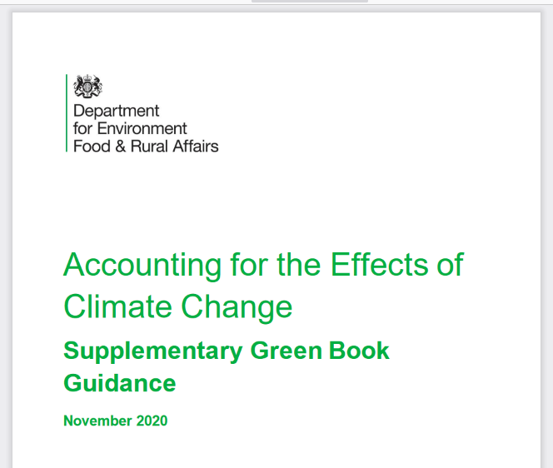
5. DEFRA 2020: TWO BASELINE SCENARIOS
“Where longer time horizons are needed (i.e. beyond 2035)… It is …necessary to appraise using at least two climate scenarios…
in appraisal; one baseline should be consistent with a ‘2°C’ scenario…and the other appraisal baseline should be consistent with a global temperature rise of 4°C. https://assets.publishing.service.gov.uk/government/uploads/system/uploads/attachment_data/file/934339/Accounting_for_the_Effects_Of_Climate_Change_-_Supplementary_Green_Book_.._.pdf

Slide 9
Until now, all transport project appraisals have used a base-line..
…which assumes road traffic increases with smooth economic growth,
national and international economies are unaffected by either climate change or policies to counter it.
‘Business as usual’ means no radical changes in weather, no radical shifts in the location of population or activities, no shortages of food, no structural changes in employment.

Slide 10
6. Urgency: Timing is not neutral
It is the stock of greenhouse gases in the atmosphere, not the annual flow of new emissions, that determines the average temperature. Their atmospheric lifetime is very long,
Therefore each tonne of carbon emitted this year does 29 years of damage by 2050. Making early reductions is much better than making late reductions.
Electrification of vehicles does not have quick effects, because the average vehicle life is now (14) years.
(and what happens to displaced petrol cars – sold to developing countries?)

Slide 11
Charging for uncharged external costs
19. “Climate change results from several market failures – most importantly that the costs of emissions to current and future generations are not borne by those who produce them today.
This can be addressed by applying an appropriate price on carbon”
(Not only carbon)

Slide 12
7. Road pricing – a cost or a benefit?
20….”rather than allow existing taxes on motoring to fall to zero, the Government could maintain the tax burden on motoring by levying other taxes such as a road-user charge”.
Charging for external costs is not a burden, it is avoiding a burden

Slide 13
8. Behaviour change – but will be more.
3.61 Around a fifth of the required reduction in emissions in 2050 is assumed to stem from behavioural changes reducing transport demand.
This is despite rising car ownership and a falling cost of driving, so it is possible other sources of abatement could need to be greater if mileage continues on the upward trend of recent years

Slide 14
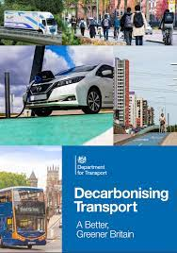
What Sort of Behaviour Changes? - the Weft
A very substantial mode shift to walking, cycling and PT in towns
Increasing car occupancy overall
Improved and more attractive long distance rail services integrated with bus-walk-cycle access
Improved intercity express coach services
Shift of road freight onto rail, shipping & cargo bikes
Embedding transport decarbonisation principles in spatial planning to ensure that new development promotes sustainable travel choices
Notes:
Half of all journeys by 2030 by walking and cycling

Slide 15
9. The Warp
“ambitious roads programme reflects – and will continue to reflect – that in any imaginable circumstances the clear majority of longer journeys, passenger, and freight, will be made by road; and that rural, remote areas will always depend more heavily on roads”
But ‘majority’ is not the point. every scheme to increase road capacity in the current DfT road programme has been appraised with forecasts of increasing road traffic: continuing well past 2050

Slide 16
Are carbon costs from the road programme significant?
DfT and Highways England: CO2 due to road schemes ‘insignificant’, ‘immaterial’, ‘negligible’, even legally ‘de minimis’ … BUT only because of
a unique definition of ‘insignificant’… carbon emissions as a percentage of all the carbon emitted from all activities in the whole economy. (only applied to roads – all other activities aggregate or offset)
And with very low ‘carbon values’

Slide 17
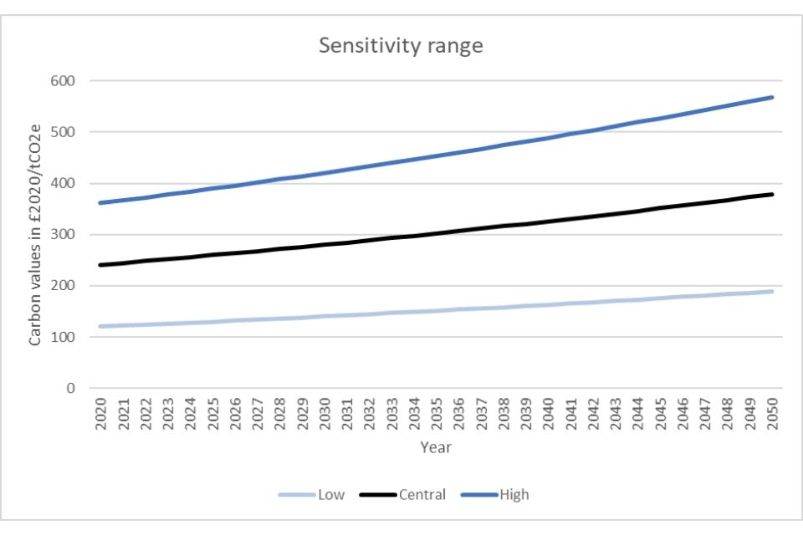
https://www.gov.uk/government/publications/valuing-greenhouse-gas-emissions-in-policyappraisal/valuation-of-greenhouse-gas-emissions-for-policy-appraisal-and-evaluation
BEIS issued revised values of carbon for appraisal. The figures for 2021 are in the order of ten times higher than the previous figures for 2021 issued in 2018, and 3-4 times higher for 2030.
An implicit statement that carbon has been substantially undervalued in all appraisals until now.

Slide 18
Do the new carbon values make a difference?
Stonehenge-A303
Old Values: carbon output 2mt, discounted average £44/tonne.
total cost of carbon £87m
NPV £101 BCR 1.08
New values (approx.)
NPV -£400m, BCR 0.7
A428 Black Cat-Caxton Gibbet
Old values: carbon output 3.3m tonnes, discounted £38 per tonne,
total cost of carbon £127m
NPV £420m, BCR 1.9
New values (approx.)
NPV -£300m, BCR 0.6

Slide 19
10. What next? Many scenarios, but dominated by TWO Futures
Runaway Climate Change
Progressively more serious effects on climate, weather, sea levels, flooding, heat waves, mass population displacement, production chains, Greater incidence of ‘Unpredicted’ emergencies affecting Coasts, rivers, flood plains, Water drainage and sewage security, medical services, Food supply and distribution
Reduced standards of living and available income. This will transform economic geography, consequent travel patterns.
This is not a future of traffic growth
2. Successful Limits to Climate Change
Deep reduction in fossil fuelled road traffic, Halt to policies and infrastructure which embed car dependence, Reinforce the advantages of active travel, and localism, Enabled by non-climate economic advantages of this approach – reduced congestion, better health:
Not necessarily reduce quality of life and effective incomes, but will require, and assist, a redefinition of national income. This will transform economic geography, consequent travel patterns,
This is not a future of traffic growth

Slide 20
Where are we now?
Ambitious sensible aspirations for electrification, and big shift from cars to public transport, walking cycling; land use planning, instruments still to be decided, but with collateral benefits for congestion, health, safety and local communities
and
‘Biggest road programme ever’ – appraised with no climate change, forecasts from another era, and carbon ‘insignificant’

Slide 21
Agenda and Conclusions
Total cost
Fiscal cost transport
Cost of global heating
Effects on Value for Money
Base-Line?
Timing
Road Pricing
Behaviour change
Roads carbon costs
Two futures
Manageable
Solvable
Disastrous
Big, not yet allowed for
Must change
Urgency – 2030 not 2050
Sensible
Essential
NOT insignificant
Neither support traffic assumptions

